Slide 1
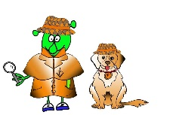
French Y3 Stage 1 Autumn1: Greetings, Feelings, asking a name .
Language Detectives’ Memory Bank: Greetings,Feelings and Names.
Greetings Bank
Bonjour – good day
Salut - hello
À bientôt – see you soon
Au revoir- good bye
Sound spelling
“ou”
“ut”
“oi”
“ça”
Question and Answer Bank
Ça va?- how are you?
Ça va bien – I am feeling good
Ça va- I am feeling okay
Comme ci comme ça- okay
Ça va mal- I am not feeling good
Grammar
When you ask a question in French you can turn a sentence into a question by raising the pitch of your voice at the end of the question.
e.g.
Ça va?
Ça va.
Question and Answer Bank
Comment t’appelles –tu?- What are you called?
Je m’appelle…. I am called…….

